Slide 1
ENERGY STAR Benchmarking & Certification Advantages for Meeting California’s Energy Efficiency Requirements
by
Corey Lee Wilson
of
CLW Enterprises

Slide 2
ENERGY STAR Benchmarking & Certifications Advantages
Who Needs a High-Performance Building in California? You do!
AB32, the California Global Warming Solutions Act of 2006 – Requires California to reduce its GHG emissions by 15 percent to 1990 levels by 2020.
Zero Net Energy (ZNE) Goals – Are targeting the reduction of GHG emissions for all new and existing commercial buildings to 40 percent below 1990 levels by the year 2030.

Slide 3
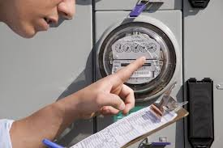
ENERGY STAR Benchmarking & Certifications Advantages
California Requires Your Existing Buildings to be Energy Efficient. And Prove It!
AB 1103: Mandatory Energy Usage Disclosure Law – Approved in 2007 and mandates energy benchmarking and energy disclosure for non-residential buildings for property transactions.
AB 758: Comprehensive Energy Efficiency in Existing Buildings Law – Approved in 2009 and requires proof of significant energy savings in existing non-residential buildings by 2020.

Slide 4
ENERGY STAR Benchmarking & Certifications Advantages
What You Don’t Know About Meeting These Requirements Will Hurt You!
AB 802: Mandatory Energy Usage Disclosure Law Replacement – Approved in 2015 now makes it much easier to access 12 months of energy use data from your local utility service providers.
SB 350: Clean Energy & Pollution Reduction Act – Approved in 2015 to double energy efficiency savings by 2030 and create a building energy-use benchmarking and disclosure program.

Slide 5
ENERGY STAR Benchmarking & Certifications Advantages
So Where Do My Building(s) Stand and Rank for Energy Usage and Efficiency?
How can you meet these aggressive energy reduction goals if you don’t benchmark your buildings for energy use and efficiency? If you haven’t already benchmarked your buildings—the time to do so is now!
Energy Reduction Targets Ahead:
2020 by 15 percent
2030 by 40 percent
2050 by 80 percent

Slide 6
ENERGY STAR Portfolio Manager calculates annual energy consumption which can be compared to other similar facilities using the International Facility Management Association’s (IFMA) benchmarking data.
Cost Effective ENERGY STAR Benchmarking
Evaluate and track a facility’s energy consumption
Help identify underperforming facilities
Generate an ENERGY STAR score
Track energy savings from implementation of energy efficient measures
Evaluate potential energy saving measures for a facility

Slide 7
After registering as a Portfolio Manager user, the next step is to create a facility in Portfolio Manager and populate the necessary data for the building with the following:
Setting Up a Facility for an ENERGY STAR Score
Essential building information
Break out space uses that are fundamentally different from the defined core building space
Twelve (12) months of monthly energy consumption data

Slide 8
EPA uses a 1-100 scale from a survey by the DOE every 4 years called the Commercial Building Energy Consumption Survey (CBECS) based on the following building characteristics:
Rating System
Environmental
Financial
GHG Emissions
Energy Use
Water Use

Slide 9
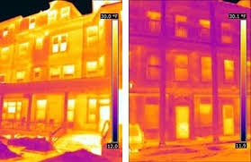
Rating System (is on the “Curve”)
From 1 to 49
From 50 to 74
From 75 to 100

Slide 10
ENERGY STAR Building Categories
• Bank branch
• Barracks
• Courthouse
• Data center
• Distribution center
• Financial office
• Hospital (general medical & surgical)
• Hotel
• K-12 school
• Medical office

Slide 11
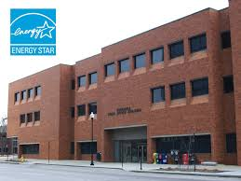
ENERGY STAR Building Categories (cont’d)
• Multi-family housing
• Non-refrigerated warehouse
• Office
• Refrigerated warehouse
• Residence hall/ dormitory
• Retail store
• Senior care community
• Supermarket/grocery store
• Wastewater treatment plant
• Wholesale club/supercenter
• Worship facility

Slide 12
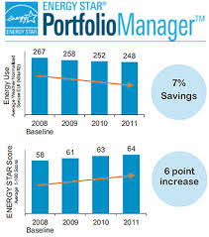
Understanding the Facility’s Performance
From 1 to 49 = First Category
From 50 to 74 = Second Category
From 74 to 100 = Third Category

Slide 13
First Category Ranking and Performance Goals
Score between 1 and 49
Performing below average
Wake-up call, underperforming
Steps to improvement may costly
Investment in energy-efficient equipment
Implement best practices for the maintenance and operation of the equipment
Greatest potential for energy and greenhouse gas reductions

Slide 14
Second Category Ranking and Performance Goals
Score between 50 and 74
Performing at average or above average levels
Steps for improvement not be as intensive as the first category
Goal is to tighten up the operation of the facility
Optimize the performance of the building’s equipment for maximum energy efficiency
Some equipment upgrades may be necessary

Slide 15
Third Category Ranking and Performance Goals
Score between 75 and 100
Performing significantly better than their peers
Eligible to receive the ENERGY STAR certification
Boasts reduced energy consumption and improved operating efficiency
Use Portfolio Manager to track further improvements in operations and equipment

Slide 16
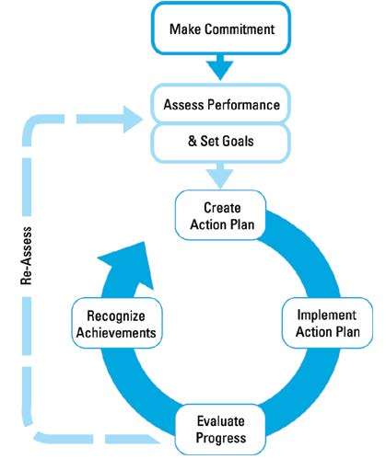
ENERGY STAR Guidelines for Energy Management: 7 Steps

Slide 17
STEP 1: Commit to Continuous Improvement
To establish their energy program, leading organizations form a dedicated energy team and/or energy champion and institute an energy policy.
Appoint an Energy Director
Establish an Energy Team
Institute an Energy Policy

Slide 18
STEP 2: Assess Performance
Gather and track data
Establish baselines
Benchmark
Analyze
Technical assessments & audits
Understanding current and past energy use is how many organizations identify opportunities to improve energy performance and gain financial benefits.

Slide 19
STEP 3: Set Goals
Setting clear and measurable goals is critical for understanding intended results, developing effective strategies, and reaping financial gains.
Determine scope
Estimate potential for improvement
Establish goals

Slide 20
STEP 4: Create an Action Plan
Successful organizations use a detailed action plan to ensure a systematic process to implement energy performance measures.
Define technical steps and targets
Determine roles and resources

Slide 21
STEP 5: Implement the Action Plan
Create a communication plan
Raise awareness
Build capacity
Motivate
Track and monitor
Gain the support and cooperation of key people at different levels within the organization is an important factor for successful action plan implementation.

Slide 22
STEP 6: Evaluate Progress
Evaluation results used by many organizations to create new action plans, identify best practices, and set new performance goals.
Measure results
Review action plan

Slide 23
STEP 7: Recognizing Achievements
Provide and seek recognition for energy management achievements as a proven step for sustaining momentum and support for your program.
Providing internal recognition
Receiving external recognition

Slide 24
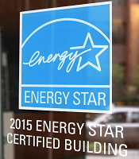
Benefits of ENERGY STAR Label Certified Buildings
5% - 10% average lower energy and utility costs
35% less operating costs than similar buildings
$2.40/sf. average higher rental and lease rates
3.6% average higher occupancy rates
68% of adults prefer energy saving firms

Slide 25
CLW Enterprises Energy Challenge
Are you and your organization’s goals to:
Lowering your energy and utility costs by 5% - 10% on average?
Achieving up to 35% less operating costs than similar buildings?
Receiving $2.40/sf. average higher rental and lease rates?
Realizing 3.6% on average higher occupancy rates?
Increasing customer/partner loyalty from the 68% of adults who prefer energy saving firms?
Great! CLW Enterprises can help.

Slide 26
CLW Enterprises Can Economically Help You Achieve Your Energy Efficiency and Cost Saving Goals.
Getting your existing building ENERGY STAR benchmarked and/or certified has many benefits and working with a Green Building Facilitator (GBF) with a LEED AP O+M credential as well as the International Facility Management Association’s (IFMA) Facility Management Professional (FMP) credential can be an excellent choice for your facility.
Want to be your organization’s energy star—but don’t have the time and resources to utilize ENERGY STAR’s comprehensive program to evaluate and measure your building’s energy usage and efficiency? No problem!
CLW Enterprises can set up your ENERGY STAR Portfolio Manager web-site portal, input the necessary data, issue the evaluation reports, and provide the energy cost saving recommendations for a one-time-fee of $1,500 to $2,500 per building. That’s a minimum cost to savings return on investment (ROI) of at least 5 to 1 against future energy cost savings.
For more information about these services and how to benchmark and/or certify your building(s), please contact Corey Lee Wilson at CLW Enterprises at (951) 415-3002 or email me at CLWEnterprises@att.net or visit my website at www.CLW-Enteprises.com.
Corey Lee Wilson
BS Economics, SBE, Member of CMAA, IFMA, DBIA, BIA and a CMAA CCM, LEED AP, and IFMA FMP

