Slide 1
BMP’s for California’s Green Building Standards (CALGreen) Code
by
Corey Lee Wilson
of
CLW Enterprises

Slide 2
AB 32 - California Global Warming Solutions Act of 2006 Started It
The passage of AB 32 required sharp reduction of greenhouse gas (GHG) emissions to a sustainable, low-carbon future.
AB 32 was the first program in the country to take a comprehensive, long-term approach to addressing climate change that aims to improve the environment and natural resources while maintaining a robust economy.
AB 32 requires California to reduce its GHG emissions to 1990 levels by 2020 — a reduction of approximately 15 percent below emissions expected under a “business as usual” scenario.

Slide 3
From AB 32 Came the Following Legislation:
Common Goals
CALGreen Code (Section 11 of Title 24) – Began in 2007 and implemented in 2009
AB1103 - California’s Mandatory Energy Benchmarking & Disclosure Assembly Bill 1103 – Passed in 2007
Zero Net Energy Standards – Started in 2008 with 2020 and 2030 targets.
Prop 39 - California Clean Energy Jobs Act – Passed in 2012
Sustainable planning, design and operations
Energy efficiency and disclosure
Water efficiency and conservation
Material conservation and resource efficiency
Environmental quality and sustainability

Slide 4
California Green Building Standards Code
CALGreen
The purpose of the California Green Building Standards Code, Section 11 of Title 24 (CALGreen for short), is to:
Improve public health, safety and general welfare.
By enhancing the design and construction of buildings.
Through the use of building concepts having a reduced negative impact or positive environmental impact.
And encouraging sustainable construction practices.

Slide 5
Benefits of Using Green Building Standards and Certification Systems
Combined utility savings up to 30% to 40%
Operating costs of green buildings can be reduced by 8 to 9%
While increasing building’s value up to 7.5%
Increases of up to 6.6% on return on investment
Occupancy increases of 3.5%
Rent increases typically 3%
Higher productivity and increased occupant health
Better indoor air quality
There are a wide range of economic and environmental benefits to sustainable operations, often achieved through the use of standards, rating, and certification systems. Some of these are:

Slide 6
The various building types and systems covered by the latest 2013 CALGreen Code starting in January 1, 2014 are the following:
State-owned buildings.
Low-rise residential buildings including hotels, motels, lodging houses, apartment houses, dwellings, dormitories, condominiums, shelters for homeless persons, congregate residences, employee housing, factory-built housing and other types of dwellings containing sleeping accommodations.
Public elementary and secondary schools, and community college buildings.
Qualified historical buildings and structures and their associated sites.
General acute care hospitals, acute psychiatric hospitals, skilled nursing and/or intermediate care facilities, and clinics.
Graywater systems.

Slide 7
Among the new CALGreen 2013 requirements, every new building as well as additions and alterations in California are subject to:
Reduce water consumption by 20%
Divert 50% of construction waste from landfills and install low VOC materials.
Separate indoor and outdoor water meters for non-residential buildings
Separate water meters and moisture-sensing irrigation systems for large landscape projects
Mandatory inspections of energy systems, furnaces and air conditioners for nonresidential buildings over 10,000 sf.
Mandatory measures in Chapter 4 apply to additions or alterations of residential buildings and specifies that requirements only apply to the specific area of the addition or alteration.

Slide 8
CALGreen looks to existing buildings with new updates because lackluster new building starts have blunted the code’s influence.
To fix this problem a new section of Chapter 5, Division 5.7 – Additions & Alteration to Existing Non-Residential Buildings was added.
Regarding school construction, CALGreen is required for any new campus that’s built and entire campuses that are rebuilt.
The trigger for existing buildings is when a project has a minimum of 1,000 sf. of construction and a minimum cost of $200,000 for additions and alterations.
Only buildings above those levels have to meet CALGreen Code requirements.
Voluntary Tier 1 and Tier 2 Measures options.

Slide 9
CALGreen goes along with all the other California building codes and standards but trumps them in places where they might differ
Similar to these other codes, local agencies have a lot of freedom to make specific amendments to the CALGreen code – those amendments apply only within that jurisdiction.
Documentation of conformance for applicable green building measures shall be provided to the enforcing agency.
Construction documents shall be of sufficient clarify to indicate the location, nature and scope of the proposed green building feature and show that it will conform to the provisions of the CALGreen code.

Slide 10
Both prescriptive and performance compliance paths require mandatory measures that must always be installed. Some examples are as follows:
Infiltrations control
Lighting
Water
Irrigation
Waste
Indoor environmental air
Roofing
Insulation
Equipment efficiency
Solar ready
Building automation systems

Slide 11
All non-residential buildings, mandatory design measures for CALGreen must be met prior to plan check submittal and review and include:
Owner’s Project Requirements (OPR)
Basis of Design (BOD)
Commissioning measures shown in construction documents
Design Review Kickoff Certificates of Compliance
Construction Document Design Review Checklist of Certificates of Compliance
Commissioning plan, functional performance testing and acceptance
Compliance forms (97 for non-residential construction!!!)
Shall be completed and signed by a licensed professional engineer(s)

Slide 12
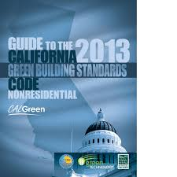
CALGreen Inspection and Commissioning Process
CALGreen calls for commissioning of commercial buildings over 10,000 sf. and commissioning is a process to verify that the building meets the owner’s specifications.
The applicant will obtain his permits from the city or county and then will need to retain the services of a commissioning coordinator to do the field verification of all the requirements of CALGreen.
At the time of final inspection a document will be presented showing compliance with CALGreen commissioning requirements and a Certificate of Occupancy can be issued.
The code allows building official to issue a temporary certificate of occupancy (if needed) and once a building passes the final inspection process, the property can then be labeled as CALGreen compliant.

Slide 13
CALGreen Resources and Additional Information
California Green Building Standards Code
http://www.bsc.ca.gov/codes.aspx
Good source for the triennial editions of Title 24 in their entirety that are updated/revised every three years.
California Energy Code Compliance for Non-Residential Projects: Plan Review, Inspection and Documentation
http://www.green-technology.org/calgreen/
Excellent seminar designed for those involved with compliance or enforcement of the non-residential provisions included in the 2013 California Energy Code that explores challenges and issues faced by designers, commissioning providers/agents, building owners and code officials.
California Building Standards Commission – CALGreen (Part 11 of Title 24)
http://www.bsc.ca.gov/Home/CALGreen.aspx
Great starting point and resource for the various CALGreen code requirements.

Slide 14
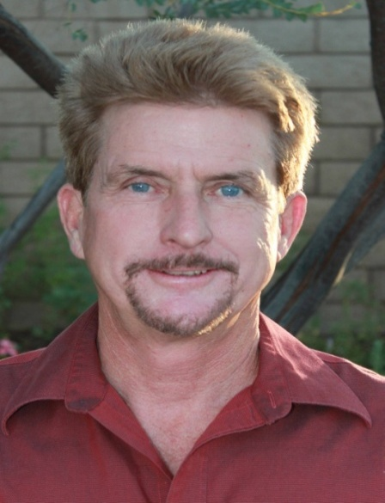
Questions, Conclusion and Contact Info
CLW Enterprises is providing a free pdf guidebook on this topic. The How to Manage California’s CALGreen Code, Zero Net Energy & AB 1103 Requirements pdf guidebook has more information than presented today, plus it has all of the information at your fingertips, including the links for those resources noted and additional ones as well.
If you would like to receive one, please let me know today or go to my website at www.CLW-Enterprises.com where you can request a free copy. Also provided for free are my How to Get Your Existing Building LEED Certified and How to Effectively Manage Your Facilities Using Sustainable Practices pdf guidebooks.
For more information about CALGreen Code, Zero Net Energy & AB 1103 requirements and the services to coordination and/or complete them, please contact Corey Lee Wilson at CLW Enterprises at (951) 415-3002 or email me at CLWEnterprises@att.net or visit my website at www.CLW-Enteprises.com.
Corey Lee Wilson
(BS Economics, SBE, Member of CMAA, IFMA, DBIA, BIA and a CMAA CCM, LEED AP, and IFMA FMP)

