Slide 1
ENERGY STAR Benchmarking for High Performance Buildings
by
Corey Lee Wilson
of
CLW Enterprises

Slide 2
ENERGY STAR Portfolio Manager calculates annual energy consumption which can be compared to other similar facilities using the International Facility Management Association’s (IFMA) benchmarking data.
ENERGY STAR Benchmarking Advantages
Evaluate and track a facility’s energy consumption
Help identify underperforming facilities
Generate an ENERGY STAR score
Track energy savings from implementation of energy efficient measures
Evaluate potential energy saving measures for a facility

Slide 3
After registering as a Portfolio Manager user, the next step is to create a facility in Portfolio Manager and populate the necessary data for the building with the following:
Setting Up a Facility for an ENERGY STAR Score
Essential building information
Break out space uses that are fundamentally different from the defined core building space
Twelve (12) months of monthly energy consumption data

Slide 4
EPA uses a 1-100 scale from a survey by the DOE every 4 years called the Commercial Building Energy Consumption Survey (CBECS) based on the following building characteristics:
Rating System
Environmental
Financial
GHG Emissions
Energy Use
Water Use

Slide 5
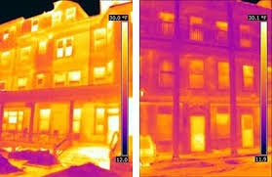
Rating System (cont’d)
From 1 to 49
From 50 to 74
From 75 to 100

Slide 6
ENERGY STAR Building Categories
• Bank branch
• Barracks
• Courthouse
• Data center
• Distribution center
• Financial office
• Hospital (general medical & surgical)
• Hotel
• K-12 school
• Medical office

Slide 7
ENERGY STAR Building Categories (cont’d)
• Multi-family housing
• Non-refrigerated warehouse
• Office
• Refrigerated warehouse
• Residence hall/ dormitory
• Retail store
• Senior care community
• Supermarket/grocery store
• Wastewater treatment plant
• Wholesale club/supercenter
• Worship facility

Slide 8
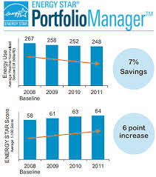
Understanding the Facility’s Performance
From 1 to 49 = First Category
From 50 to 74 = Second Category
From 74 to 100 = Third Category

Slide 9
First Category Ranking and Performance Goals
Score between 1 and 49
Performing below average
Wake-up call, underperforming
Steps to improvement may costly
Investment in energy-efficient equipment
Implement best practices for the maintenance and operation of the equipment
Greatest potential for energy and greenhouse gas reductions

Slide 10
Second Category Ranking and Performance Goals
Score between 50 and 74
Performing at average or above average levels
Steps for improvement not be as intensive as the first category
Goal is to tighten up the operation of the facility
Optimize the performance of the building’s equipment for maximum energy efficiency
Some equipment upgrades may be necessary

Slide 11
Third Category Ranking and Performance Goals
Score between 75 and 100
Performing significantly better than their peers
Eligible to receive the ENERGY STAR certification
Boasts reduced energy consumption and improved operating efficiency
Use Portfolio Manager to track further improvements in operations and equipment

Slide 12
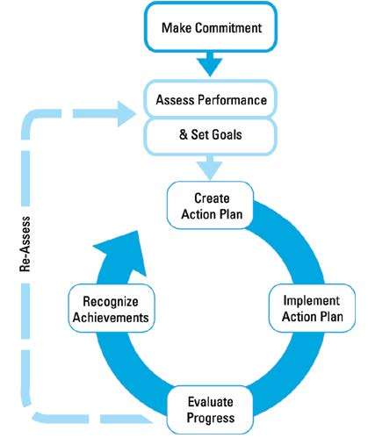
ENERGY STAR Guidelines for Energy Management: 7 Steps

Slide 13
STEP 1: Commit to Continuous Improvement
To establish their energy program, leading organizations form a dedicated energy team and institute an energy policy.
Appoint an Energy Director
Establish an Energy Team
Institute an Energy Policy

Slide 14
STEP 2: Assess Performance
Gather and track data
Establish baselines
Benchmark
Analyze
Technical assessments & audits
Understanding current and past energy use is how many organizations identify opportunities to improve energy performance and gain financial benefits.

Slide 15
STEP 3: Set Goals
Setting clear and measurable goals is critical for understanding intended results, developing effective strategies, and reaping financial gains.
Determine scope
Estimate potential for improvement
Establish goals

Slide 16
STEP 4: Create an Action Plan
Successful organizations use a detailed action plan to ensure a systematic process to implement energy performance measures.
Define technical steps and targets
Determine roles and resources

Slide 17
STEP 5: Implement the Action Plan
Create a communication plan
Raise awareness
Build capacity
Motivate
Track and monitor
Gain the support and cooperation of key people at different levels within the organization is an important factor for successful action plan implementation.

Slide 18
STEP 6: Evaluate Progress
Evaluation results used by many organizations to create new action plans, identify best practices, and set new performance goals.
Measure results
Review action plan

Slide 19
STEP 7: Recognizing Achievements
Provide and seek recognition for energy management achievements as a proven step for sustaining momentum and support for your program.
Providing internal recognition
Receiving external recognition

Slide 20
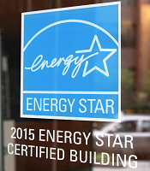
Benefits of ENERGY STAR Label Certified Buildings
5% - 10% average lower energy and utility costs
35% less operating costs than similar buildings
$2.40/sf. average higher rental and lease rates
3.6% average higher occupancy rates
68% of adults prefer energy saving firms

Slide 21
Questions, Conclusion and Contact Info
Getting your existing building ENERGY STAR benchmarked and/or certified has many benefits and working with a Green Building Facilitator (GBF) with a LEED AP O+M credential as well as the International Facility Management Association’s (IFMA) Facility Management Professional (FMP) credential can be an excellent choice for your facility.
Want to be your organization’s energy star—but don’t have the time and resources to utilize ENERGY STAR’s comprehensive program to evaluate and measure your building’s energy usage and efficiency?
CLW Enterprises can set up your ENERGY STAR Portfolio Manager web-site portal, input the necessary data, and provide the evaluation reports for a one-time-fee of $1,500 to $2,500 per building. That’s a minimum cost to savings return on investment (ROI) of at least 5 to 1.
For more information about these services and how to benchmark or certify your building, please contact Corey Lee Wilson at CLW Enterprises at (951) 735-2646 or CLWEnterprises@att.net or visit my website at www.CLW-Enterprises.com.
Corey Lee Wilson
(BS Economics, SBE, Member of CMAA, IFMA, DBIA, BIA and a CMAA CCM, LEED AP, and IFMA FMP)

