Slide 1
Design-Build Bridging Method of Project Delivery
by
Corey Lee Wilson
of
CLW Enterprises

Slide 2
What is Bridging?
The Bridging method of construction project delivery is a hybrid of the traditional Design-Bid-Build and the Design-Build methods.
It retains the elements of each that are most advantageous to the Owner and eliminates those that work against the Owner’s best interests.
It is particularly useful to Owners who cannot rely upon “relationships” or make “single source” procurements for construction contracts.
It is applicable to all types and sizes of public and private projects including complex ones in any location or any market.
The key element of its success is the use of an Owner’s Design Consultant (ODC) also referred to as a Bridging Architect or Design Architect.

Slide 3
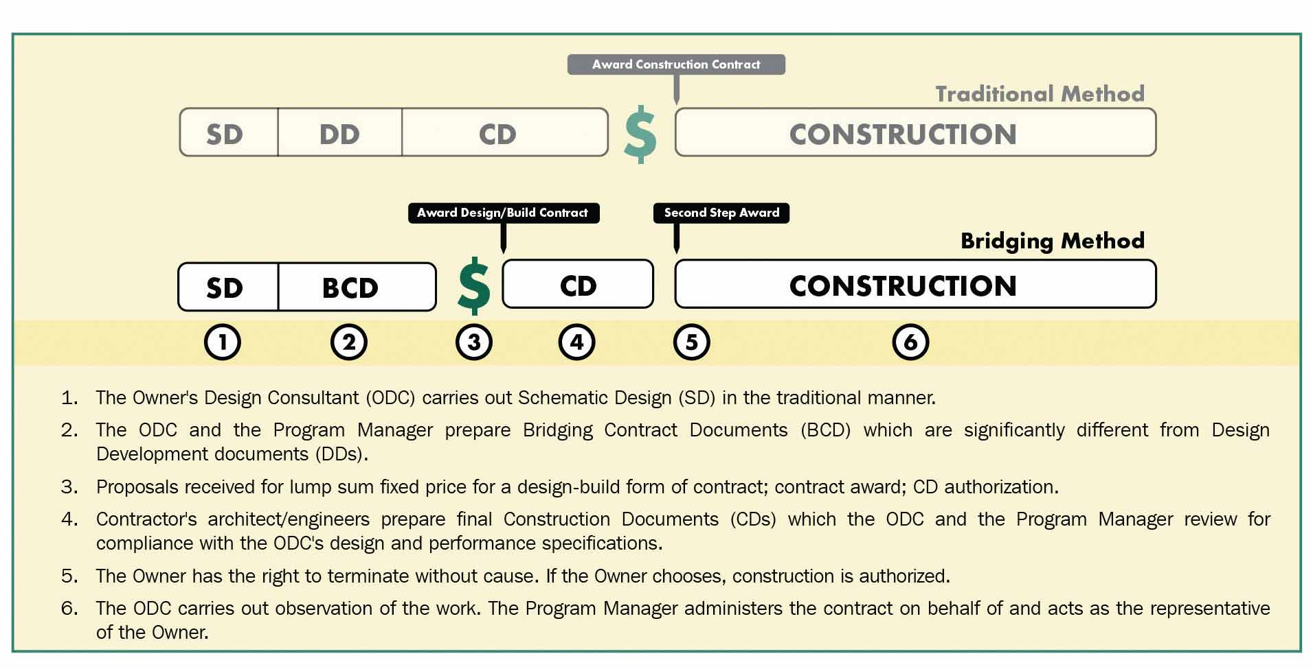
Traditional Design-Bid-Build vs. Bridging

Slide 4
The Major Benefits of Bridging to the Owner
When properly carried out, Bridging provides the Owner with a dependable contract price for the final design and construction at a point about halfway through the design process and with only about half the design cost compared to the traditional Design-Bid- Build method.
The price obtained by Bridging at this earlier point, is more enforceable than a price obtained by either CM-at-Risk (CMAR) or so-called “Guaranteed” Maximum Price (GMP) methods.
On most projects, Bridging will shorten the construction time due to the Contractor’s more intensive planning and input during the preparation of the final drawings and specifications.
Bridging facilitates the integration of both more advanced construction technology and more practical construction knowledge into the design process without giving up control of the design or the quality of the end product.
When properly used, Bridging greatly reduces the Owner’s exposure to construction risks including contractor initiated change orders, claims, and delays/disputes in resolving flaws in the design or construction discovered after occupancy.
After occupancy, if there is a defect requiring correction, Bridging provides a clear, single responsibility for correcting the work at no cost to the Owner.
By utilizing all of the above benefits—an Owner’s design and construction costs are significantly reduced compared to other methods.
For the last two decades Design-Build has become increasing popular with Owners, Architects, and Contractors vs. the traditional Design-Bid-Build process due to the typical 6% savings on construction costs as well as helping to deliver projects 33% faster than the traditional Design-Bid-Build process.

Slide 5
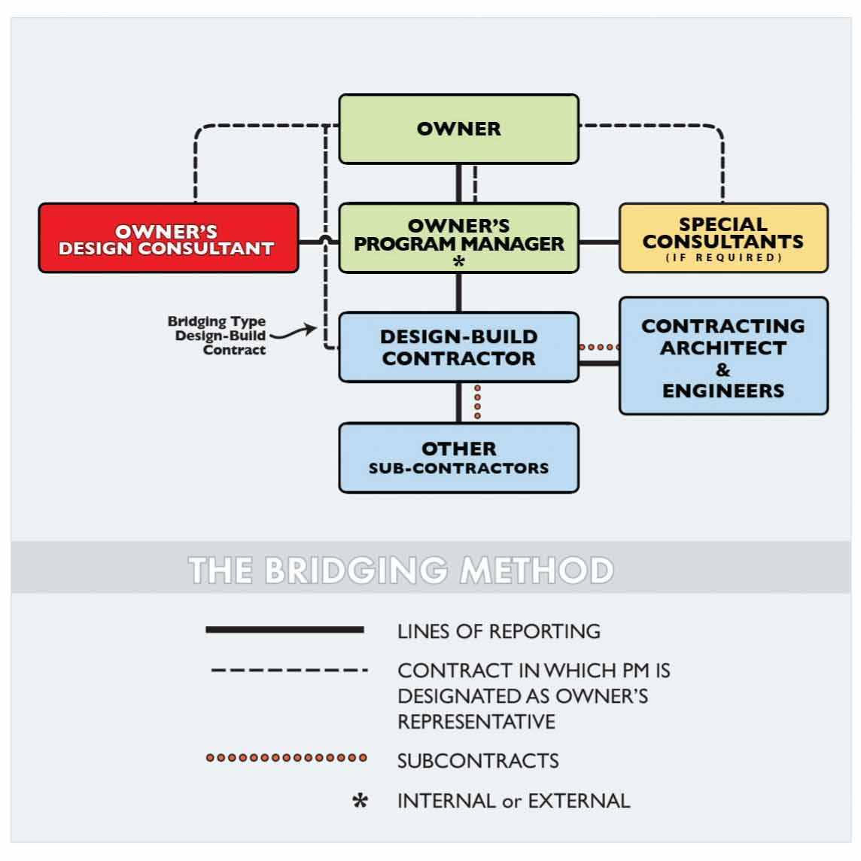
Typical Bridging Team:
Owner
Program Manager (PM)
Construction Manager (CM)
Owner’s Design Consultant (ODC) or Designer
Consulting Engineers (as required by Owner, PM, or ODC)
Design-Build Contractor (DBC) or Contractor
Contractor’s Architect & Engineers (AE) is typically a subcontractor to the DBC

Slide 6
Typical Design and Bridging Terms
Project Development
Schematic Design (SD)
Development Documents (DD) are typically 40-60% of the design cost in DBB
Contract Documents (CD)
Bridging Contract Documents (BCD)
Owner’s Minimum Requirements (OMR)
Design Guide Illustrations (DGI)
Construction Documents (CD) not to be confused with other CD for Contract Documents

Slide 7
The 6 Steps in the Bridging Method Process
Step 1 - Schematic Design (SD) Phase
Step 2 - Preparing the Bridging Contract Documents (BCD)
Step 3 - Bid and Award Phase (Award 1st contract for construction plans/docs to DBC)
Step 4 - Preparation of the construction plans/docs by the DBC’s AE
Step 5 - Second Step Award (Award 2nd contract for project construction to DBC)
Step 6 – Construction by Design-Build Contractor (DBC)

Slide 8
Step 1 - Schematic Design (SD) Phase
The PM (or CM) assists the Owner in selecting and contracting with the Owner’s Design Consultant (ODC) during Project Development. The ODC produces the Schematic Design work in essentially the same manner that is typical for most Architects under the traditional Design-Bid-Build method, except:
The only difference between the traditional approach in carrying out schematic design and the approach under Bridging has to do with the early selection of engineered systems.
In Design-Bid-Build (DBB), this is usually done or considered by the Architect at the end of the schematic design phase or at the start of DD under the traditional method, but not in Bridging.
Under Bridging, due to the cost benefits to the Owner, the ODC should leave as much latitude to the Design-Build team in the detailed design of engineered systems as is feasible without affecting the Owner’s requirements or the ODC’s design parameters.

Slide 9
Step 1 - Schematic Design Phase - Example
If the Owner’s Design Consultant (ODC) determines that the design will best be carried out with an independent structured frame, the ODC is encouraged to allow in the architectural design sufficient space for several different types of independent structural frame systems. In a building with an independent structural frame of typical bays, this might include four (4) options for a:
fireproofed structural steel frame
cast-in-place reinforced concrete frame with alternative forming systems for the floor structure
cast-in-place, post tensioned reinforced concrete system
pre-cast reinforced concrete system
The Contractor, subsequent to being awarded the project, and their AE, will propose the best method of the four (4) systems in their bid.

Slide 10
Step 2 - Bridging Contract Documents
More AE design and detailing will be done in the Bridging Contract Documents (BCD) phase under Bridging than is completed in the traditional Design Development phase. However, few if any drawings of engineered systems will be prepared. Later, the Design-Build Contractor’s AE will prepare more detailed construction drawings and specifications (essentially shop drawings and submittals) for the remaining design and engineered systems. The Bridging Contract Documents (BCD) will include the following:
Owner’s Minimum Requirements (OMR) are the specifications prepared by the ODC. They or the Agreement will include General and Special Conditions along with all other requirements for the project. As much latitude should be left to the Contractor and its AE for their proposed systems and final design. The technical part of this document should rely as much as feasible on performance type specifications, but the OMR will usually include some prescriptive specifications.
Design Guide Illustrations (DGI) are the drawings prepared by the ODC in consultation with the required Consulting Engineers during this phase and may be quite extensive, due to Owner and Designer objectives.
The “DGI” and “OMR” are the nomenclature used for the “Bridging Contract Documents” and are different from the “Construction Documents” that will be prepared later by the Contractor’s AE upon authorization to proceed (1st Phase award).

Slide 11
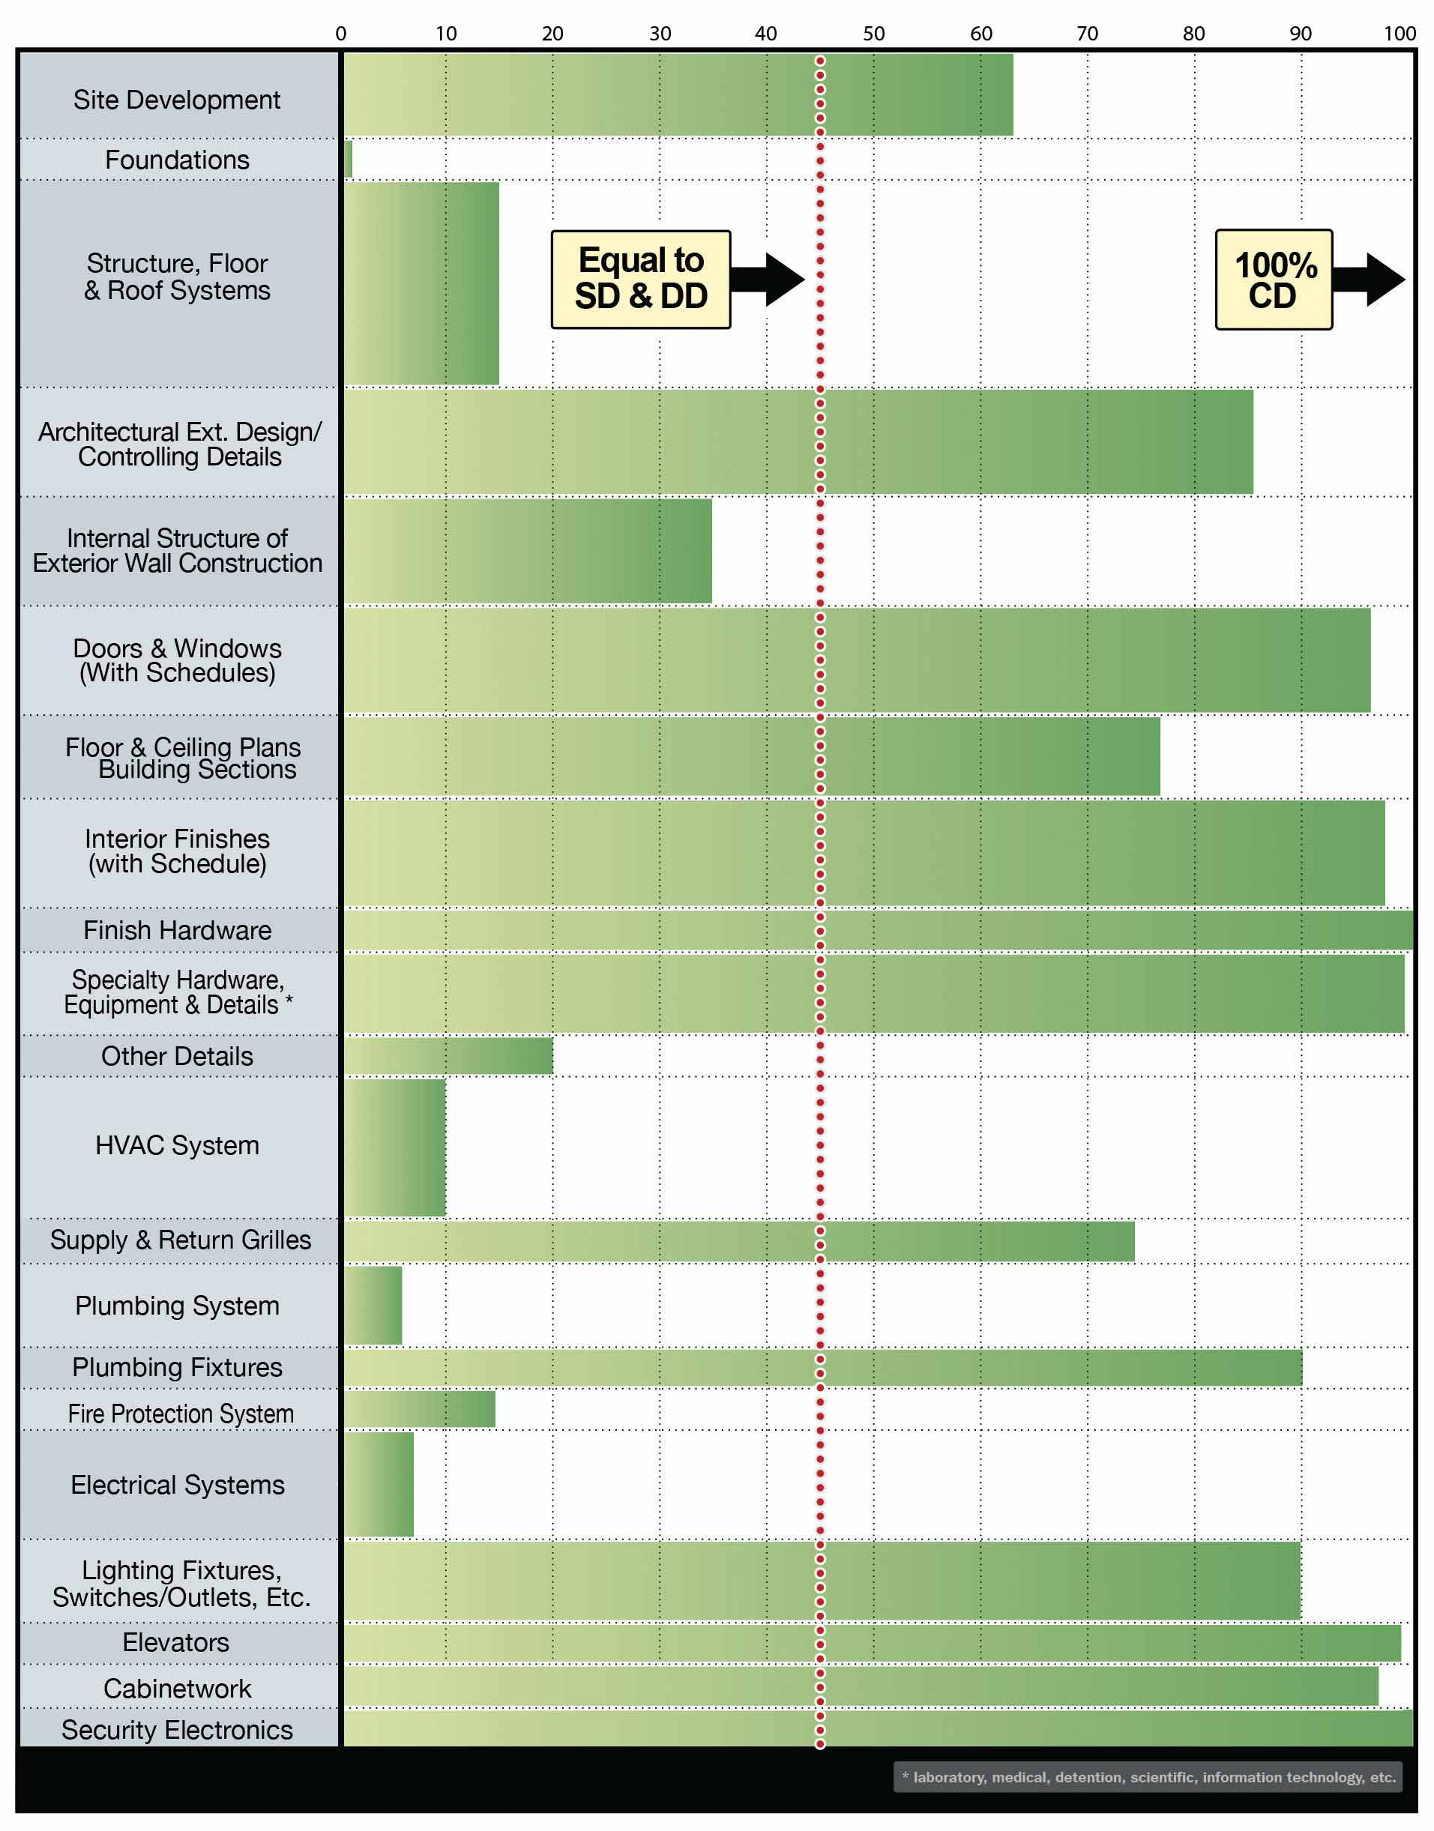
Step 2 - Preparing the Bridging Contract Documents:
Bridging Contract Documents go further than DD documents in many respects, such as hardware and plumbing fixtures, but not as far in such things as type of foundation or detailed MEP behind the walls and under the floors.
The bar charts of the typical design systems and the percent completed typically needed for the Bridging Contract Documents illustrate this key distinction between Bridging contract docs and Design-Bid-Build contract docs.

Slide 12
Step 2 - Preparing the Bridging Contract Documents - Three Important Objectives
The Bridging Contract Documents (BCD) prepared by the ODC and the Owner’s PM (internal or external) remain the Contract Documents of the Agreement between the Owner and the Contractor throughout the project.
The Construction Documents, prepared later by the Design-Build Contractor’s AE, supplement but do not supplant the BCDs prepared by the ODC so that the Owner is contractually entitled to everything required by both documents.
Bridging fully meets the most restrictive of public procurement policies and rules in that a specific end product has been documented, the Bridging Contract Documents provide that a fixed-price, competitive bid be received, and the Owner has a highly enforceable contract of which the fixed price and schedule is a part.

Slide 13
Steps 3, 5 and 4 – No Significant Changes to the Design-Bid-Build Method
Step 3 - Bid and Award Phase (Award 1st contract for construction plans/docs to DBC)
Step 5 - Second Step Award (Award 2nd contract for project construction to DBC)
Step 6 – Construction by Design-Build Contractor (DBC)

Slide 14
Step 4 - Preparation of the Construction Documents by the Contractor’s AE
The Contractor’s AE carries out detailed engineering design and the final preparation of the AE “working drawings” in accordance with the DGI and the OMR which are major parts of the Bridging Contract Documents. The OMR would have included the detailed engineering criteria.
The ODC monitors and reports to the PM and should not take on for the Owner, for the PM, nor for itself, the responsibility of detailed checking and approval of the Construction Documents (CD). Instead, the Owner, PM and ODC will have them available for “optional” review for a grace period stated in the Bridging Contract Documents.
Neither the ODC nor the PM should ever relieve the Contractor of its responsibilities by written or verbal communication to the effect that the CDs have been “checked” or “approved”. The correct position for the ODC is to be silent if the CDs have been found to be in full compliance, but clearly state the CDs are not in compliance and require re-submittal when required.

Slide 15
So Why Aren’t More Owners Using Bridging?
Didn’t know it existed?
Not aware of the significant benefits?
No experience or track record using the Bridging method?
Intimidated by the Design-Build method?
Need help explaining the benefits of Design-Build and Bridging to stakeholders?
Other reasons?

Slide 16
Questions, Conclusions and Contact Info
Making the jump from Design-Bid-Build with its many inherent flaws to the Design-Build Bridging Method of project delivery with its many benefits can be challenging at first. If not executed properly, many of the benefits are never realized. Working with a Project Manager like me with over $100m and 24 years of Project Management experience for commercial, retail, industrial, medical, and school construction projects can be a major benefit.
Add my credentials as a Certified Construction Manager (CCM) from the Construction Management Association of America (CMAA), LEED AP O+M credential from the US Green Building Council, as well as the Facility Management Professional (FMP) credential from the International Facility Management Association (IFMA)—and I can be an excellent choice for your design-build project delivery needs.
For more information about how I can effectively assist your project with implementing design-build project delivery, please contact Corey Lee Wilson at CLW Enterprises at (951) 415-3002, or e-mail me at CLWEnterprises@att.net or visit my website at www.CLW-Enteprises.com.
Corey Lee Wilson
BS Economics, SBE, Member of CMAA, IFMA, DBIA, BIA and a CMAA CCM, LEED AP, and IFMA FMP)

