Slide 1
How to Get Your Existing Building LEED Certified
by
Corey Lee Wilson
of
CLW Enterprises

Slide 2
Why Go Green?
For The Environment
For The Savings
For Your Health
For Other Reasons

Slide 3
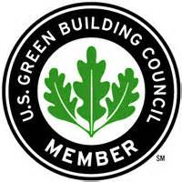
USGBC & LEED Introduction
The United States Green Building Council (USGBC) is the leader in green building certification and sustainability for the built environment and pursues solutions that represent a healthy and dynamic balance between environmental, social, and economic benefits—known as the triple bottom line. Their building certification rating system is known as the Leadership in Energy and Environmental Design (LEED).

Slide 4
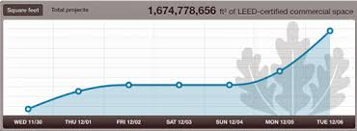
Existing Building vs. New Building LEED Certification
Existing Building
New Building
Based on the sustainability “design” points for a new building
Certification is good for the life of the building
Provided its occupancy type has not changed
Nor has it undergone any remodels and additions.
Fewer new buildings certified
Based on an existing building’s sustainable “operations and maintenance” performance
Recertification is required by USGBC every 5 years
First time LEED EBOM certification
More existing buildings certified
EBOM has overtaken new construction certification

Slide 5
LEED EBOM Introduction
The LEED-EBOM rating system provides prescriptive strategies for addressing the ongoing operation, maintenance, and the overall performance of existing buildings through the reduction of energy consumption and water use, as well as the pollution associated with the generation and transportation of these commodities. Additionally, the rating system provides several measures to create and validate a sustainable facility, including the following:
Exterior building and site cleaning and maintenance
Interior green cleaning
Integrated pest management
Sustainable and environmentally-preferable purchasing policies for standard office accessories, electronic goods and furniture, construction materials, and lamps/bulbs
Solid waste management programs for standard waste, electronic and furniture waste, and construction waste
Ongoing indoor air quality

Slide 6
LEED EBOM Introduction (Cont’d)
Furthermore, the LEED EBOM rating system stresses occupant comfort, which requires ongoing indoor air quality (IAQ) best management practices. This is achieved by implementing annual building IAQ practices, outdoor air delivery monitoring, and high-efficiency filtration media on fans, as well as individual controllability of lighting and thermal conditions, and accessibility to ambient daylight and exterior views. To validate these requirements, perform the following:
Whole-building energy audits
Comprehensive preventive maintenance measures and system/equipment calibration
Existing building commissioning, including (1) investigation/analysis, (2) implementation, and (3) ongoing commissioning
Energy performance verification using the U.S. EPA’s ENERGY STAR Portfolio Manager® program, an online tool used to measure and track energy and water consumption as well as greenhouse gas emissions

Slide 7
Benefits of Using Green Building Standards and Certification Systems
Combined utility savings up to 30% to 40%
Operating costs of green buildings can also be reduced by 8 to 9%
While increasing building’s value up to 7.5%
Increases of up to 6.6% on return on investment
Occupancy increases of 3.5%
Rent increases of 3%
Higher productivity and increased occupant health
Better indoor air quality
There are a wide range of economic and environmental benefits to sustainable operations, often achieved through the use of standards, rating, and certification systems. Some of these are:

Slide 8
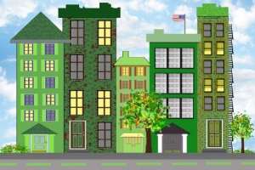
Why Pursue a Green Building Rating or Certification?
The reasons for pursuing a green building certification for a project are varied
Type of certification system pursued depends upon that singular project
None of these certification systems are one-size-fits all
Choice is dependent upon the uniqueness of each project
Plus requirements such as the project location, size, budget, and overall project goals

Slide 9
How to Get Started
Update the ENERGY STAR Portfolio Manager page for the property to confirm the current ENERGY STAR score
Review the recent USGBC guidance on the recertification process
Use initial certification to identify goals for the recertification process and pain points that should not be repeated.
Engage service providers to budget estimates and assess operational cost savings potential of the certification process.
If this is the first LEED EBOM certification, consult with a Green Building Facilitator to survey your building and determine its potential for LEED EBOM certification.

Slide 10
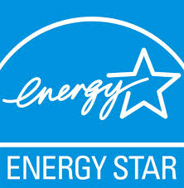
Energy STAR, Energy Use Intensity, and Benchmarking
Owners must submit data via the U.S. EPA’s ENERGY STAR Portfolio Manager web portal for benchmarking.
Portfolio Manager is an interactive tool that allows an owner to track and assess energy and water consumption across its entire portfolio of buildings.
Energy Use Intensity (EUI) is simply the energy consumption of a thing, divided by a key descriptive factor of the thing.
Start the Energy and Atmosphere (EA-2) credit rating for LEED EBOM right now as its performance period lasts a minimum of 12 months.

Slide 11
Certification Team
Typical project team consists of:
Facility Manager/Director
Green Building Facilitator
Commissioning Agent
Energy Audit Engineer
Other service providers if needed

Slide 12
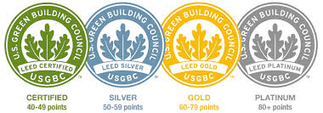
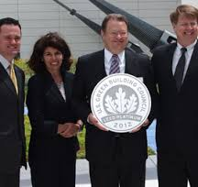
FM and O&M Goals
Validation of ongoing sustainable operations is the next step for existing buildings and will grow in importance.
Facility managers need to shift their thinking about using LEED EBOM for their non-certified buildings.
LEED EBOM certification has evolved into the framework for verifying high performance building operations.
If done right, certification will lead to a streamlined building operations and maintenance.

Slide 13
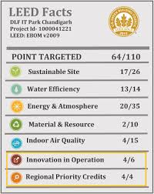
What’s Being Rated: 7 Certification Credit Categories
All LEED building certification rating systems are based on the following credit categories:
Sustainable Sites
Water Efficiency
Energy & Atmosphere
Materials & Resources
Indoor Environmental Air Quality
Innovation in Operations
Regional Priority

Slide 14
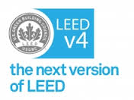
LEED EBOM Versions
LEED Version 2.0
Oldest version will need to convert to the 2009 version for recertification
LEED Version 3.0 (2009)
Current LEED EBOM certification system in use until October 31, 2016
LEED Version 4.0
Newest version released July 1, 2014 will be mandatory for all projects registered after October 31, 2016

Slide 15
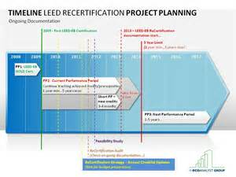
Certification Process and Timelines
Identify target points approach and responsibilities (approx. 3 months)
Implementation (prior to performance period, plan for a least 3 – 6 months)
Performance period (at least 3 months for most credits, 12 months minimum for energy performance)
Documentation submittal and project completion via LEED Online (within 60 days of performance period completion)
USGBC review including preliminary and final rounds (allow 30 days for each round of review)
Certification (after final review)
The LEED EBOM certification process typically takes between 12 to 18 months from start to finish to completion. Every building is unique and so are the approaches, processes, and timelines. For a “typical” building, the key steps and time frames are as follows:

Slide 16
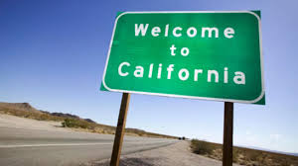
Other Important Considerations
AB 32 - California Global Warming Solutions Act of 2006
California’s Zero Net Energy (ZNE) Standards
CALGreen - Part 11 of the California Building Standards Code (Title 24 of the California Code of Regulations)
AB1103 - California’s Mandatory Energy Benchmarking & Disclosure Assembly Bill 1103
Prop 39 - California Clean Energy Jobs Act

Slide 17
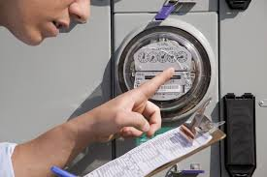
California’s Zero Net Energy (ZNE) Standard
In 2008 the California Public Utility Commission (PUC) issued its Zero Net Energy (ZNE) goals:
All new residential construction by 2020
All new commercial buildings by 2030.
2013 Energy Code will reach 70% of the residential ZNE goal
2016 Energy Code will reach 85% of the residential ZNE goal
2019 Energy Code will meet the 100% residential goal of ZNE
By 2030 every new school is supposed to be a zero net energy building
A (ZNE) is a building with zero net energy consumption, meaning the total amount of energy used by the building on an annual basis is roughly equal to the amount of renewable energy created on the site.

Slide 18
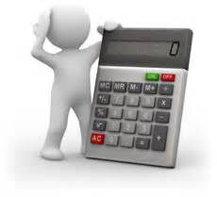
LEED EBOM Certification Costs $$$
LEED Certification Program Fees
Typical registration and review fees range from $1,500 – $20,000. This fee range is based on buildings of 3 size ranges: less than 50,000 sf, between 50,000 – 500,000 sf., and a maximum fee of $20,000 for buildings larger than 500,000 sf. These fees can be lowered between $500 to $5,000 if the project administrator is a USGBC member. All prices are per single building.
Project Consultant (Green Building Facilitator)
Typical consulting fees range from $40k – $60k per building for LEED AP’s to facilitate and coordinate with the preparation and submittal of all documentation for LEED EBOM certification.
Other Service Providers
There may be additional costs for a commissioning agent, energy audit engineer, and other specialized services that would be unique to the existing building’s certification requirements.

Slide 19
4 More Great Reasons to Get LEED EBOM Certification
Maybe you’re still wondering if LEED EBOM is the right way to go. If you’re a facility manager or building owner and you’re not sure if it’s “worth it” to apply for LEED EBOM certification—it may not be if you DON’T believe in:
Saving money
Adding value to your building
Receiving recognition
Working smarter

Slide 20
Loans, Grants and Tax Breaks Resources for Energy Efficiency Upgrades in California
California Financial Incentives for Renewables and Energy Efficiency (DSIRE):
http://dsireusa.org/incentives/index.cfm?re=0&ee=0&spv=0&st=0&srp=1&state=CA
The Database of State Incentives for Renewable Energy (DSIRE) is a comprehensive source of information on state, local, utility, and selected federal incentives. DSIRE is the most comprehensive source of information on incentives and policies that support renewables and energy efficiency in the United States and covers residential, commercial, and government programs.
Property Assessed Clean Energy Financing (PACE):
http://energycenter.org/policy/property-assessed-clean-energy-pace
PACE financing allows property owners to fund energy efficiency, water efficiency and renewable energy projects with little or no up-front costs. With PACE, residential and commercial property owners living within a participating district can finance up to 100% of their project and pay it back over time as a voluntary property tax assessment through their existing property tax bill.
SCE and SCG Business Energy Saving Incentive Programs:
https://www.sce.com/wps/portal/home/business/savings-incentives/solar-rebate/
http://www.socalgas.com/for-your-business/

Slide 21
Loans, Grants and Tax Breaks Resources for Energy Efficiency Upgrades in California (Continued)
Go Solar California!:
Incentives for businesses that implement solar technologies.
http://www.gosolarcalifornia.ca.gov/
Energy Efficiency Financing:
http://www.energy.ca.gov/efficiency/financing/index.html
The Energy Efficiency Financing Program provides financing for schools, hospitals and local governments through low-interest loans for feasibility studies and the installation of energy-saving measures used for government, industry, and non-profits.
Federal Tax Credits for Energy Efficiency:
https://www.sba.gov/content/federal-tax-credits-energy-efficiency
A tax credit can provide significant savings and reduces the amount of income tax you have to pay. Unlike a deduction, which reduces the amount of income subject to tax, a tax credit directly reduces the tax itself.
California Appliances Database:
http://www.energy.ca.gov/appliances/database/
Downloadable database of all appliances currently certified to the California Energy Commission by their manufacturers as meeting currently-applicable efficiency standards.

Slide 22
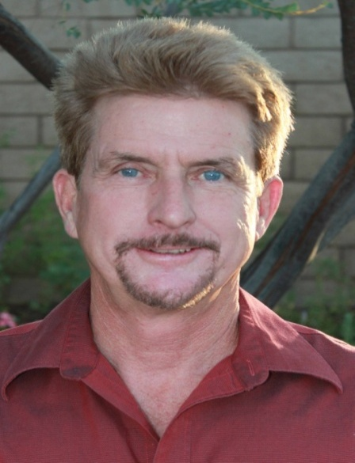
Questions, Conclusion and Contact Info
Getting your existing building LEED EBOM certified has many benefits. Working with a Green Building Facilitator (GBF) with a LEED AP O+M credential as well as the International Facility Management Association’s (IFMA) Facility Management Professional (FMP) credential can be an excellent choice for your LEED EBOM.
CLW Enterprises is providing free of charge a How to Get Your Existing Building LEED Certified pdf guidebook on this topic. The pdf guidebook has more information than this PowerPoint presentation, plus it has all of the information at your fingertips, including the links for those resources noted and additional ones as well. If you would like to receive one, please let me know today or go to my website at www.CLW-Enterprises.com where you can request a free copy.
For more information about LEED EBOM certification requirements and the services to complete them, please contact Corey Lee Wilson at CLW Enterprises at (951) 415-3002 or email me at CLWEnterprises@att.net or visit my website at www.CLW-Enteprises.com.
Corey Lee Wilson
(BS Economics, SBE, Member of CMAA, IFMA, DBIA, BIA and a CMAA CCM, LEED AP, and IFMA FMP)

